Slide 1
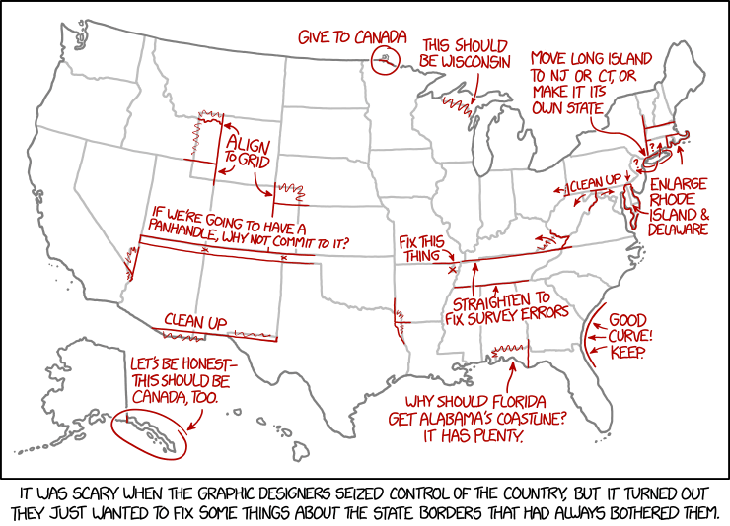
User interface design
xkcd

Slide 2
UI Design: Week 4
Dr. Jillian Aurisano
Plan for today:
Announcements/Course logistics
Graphic Design – gestalt principles, layout and alignment

Slide 3
Design
Simplicity
Gestalt principles
Layout
Grouping and Hierarchy
Symmetry
Alignment and Grids
Color

Slide 4
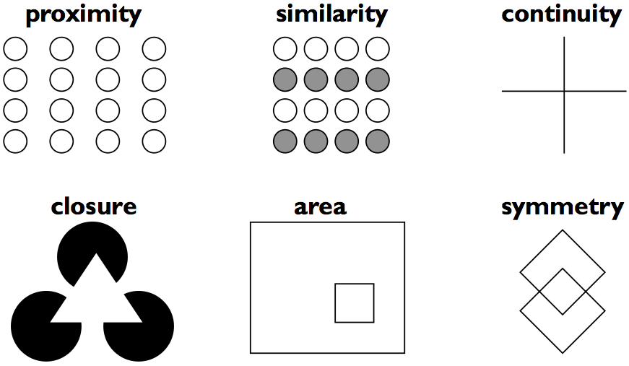
Psychological principle: Gestalt principles
1923 work: Gestalt laws of perceptual organization
We don’t ‘just see things’
Our brains do work to construct what we ‘see’
Gestalt principles are valuable to design

Slide 5
Gestalt principle
The human brain will attempt to simplify and organize complex images or designs that consist of many elements,
By subconsciously arranging the parts into an organized system that creates a whole, rather than just a series of disparate elements.
Our brains are built to see structure and patterns in order for us to better understand the environment that we’re living in.

Slide 6
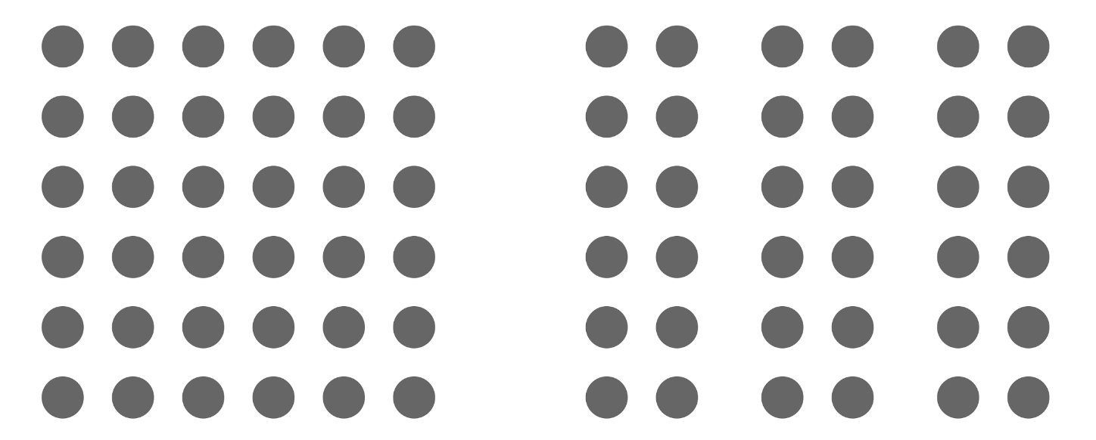
Proximity principle
Look at the figure on the left and the one on the right
On the right- do you think of those elements as members of 3 different groups?
Proximity is interpreted by our brains as relatedness

Slide 7

Proximity vs color- which wins?
Do you see groups based on color or based on proximity?

Slide 8
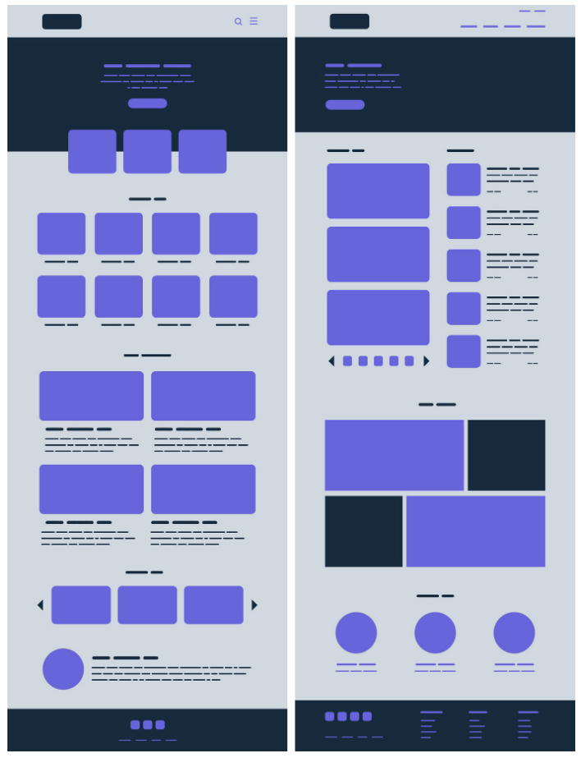
Proximity principle and UI design
Use the Proximity principle in UI design
grouping similar information,
organizing content
decluttering layouts.
Positioning is part of communication with your user
When you look at these webpages, do you have a sense of which content is related?

Slide 9
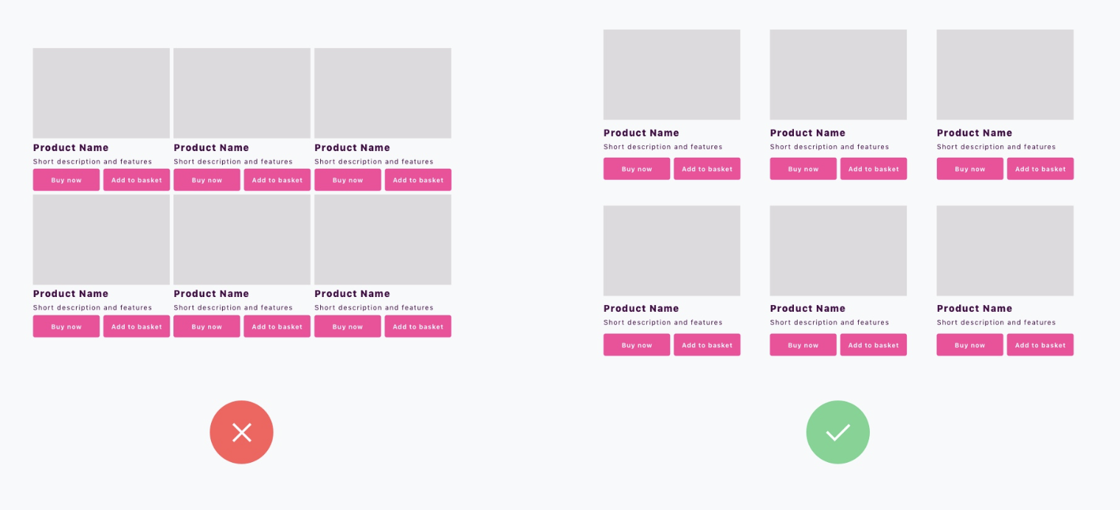
Which of these use the proximity principle?

Slide 10
Which of these use the proximity principle?

Slide 11
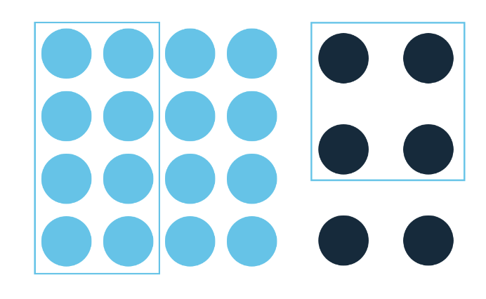
Common region principle
Related to proximity
Elements placed within the same region or bounding box are perceived as grouped.

Slide 12
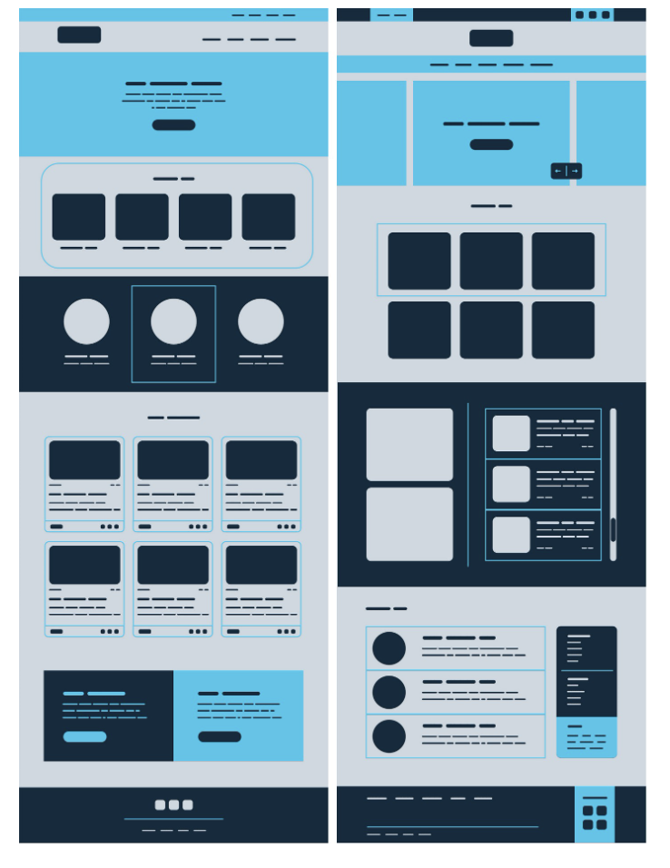
Common region principle and UI design
You can use the common region principle to hold together many different elements keeping them unified within larger groups.
We can achieve it with the use of line, color, shape and shadow.
It can often be used to bring elements into the foreground, indicating interaction or importance.
Helps people quickly and accurately understand groupings.

Slide 13
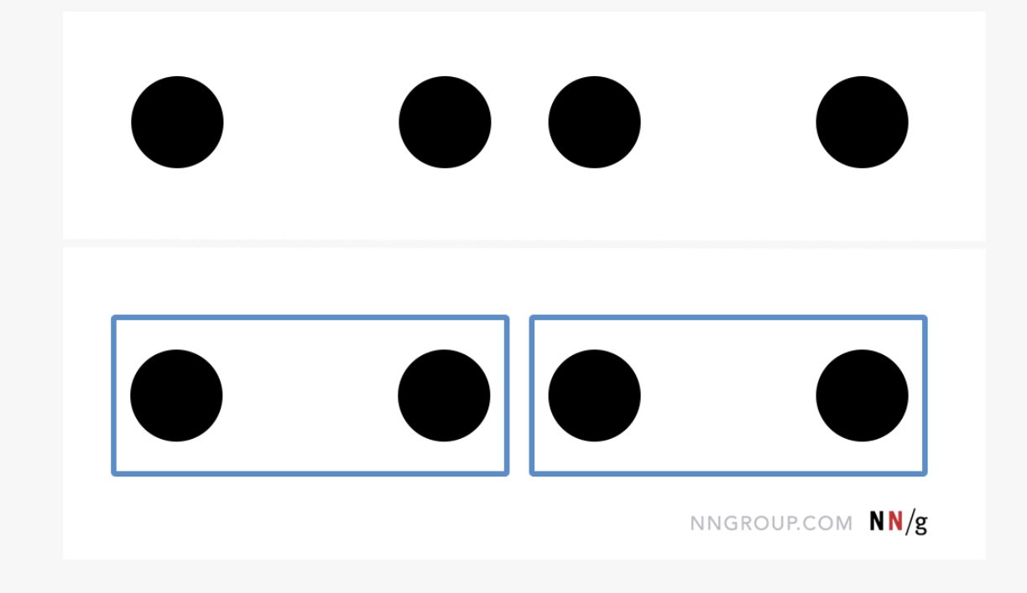
Common region vs other channels

Slide 14
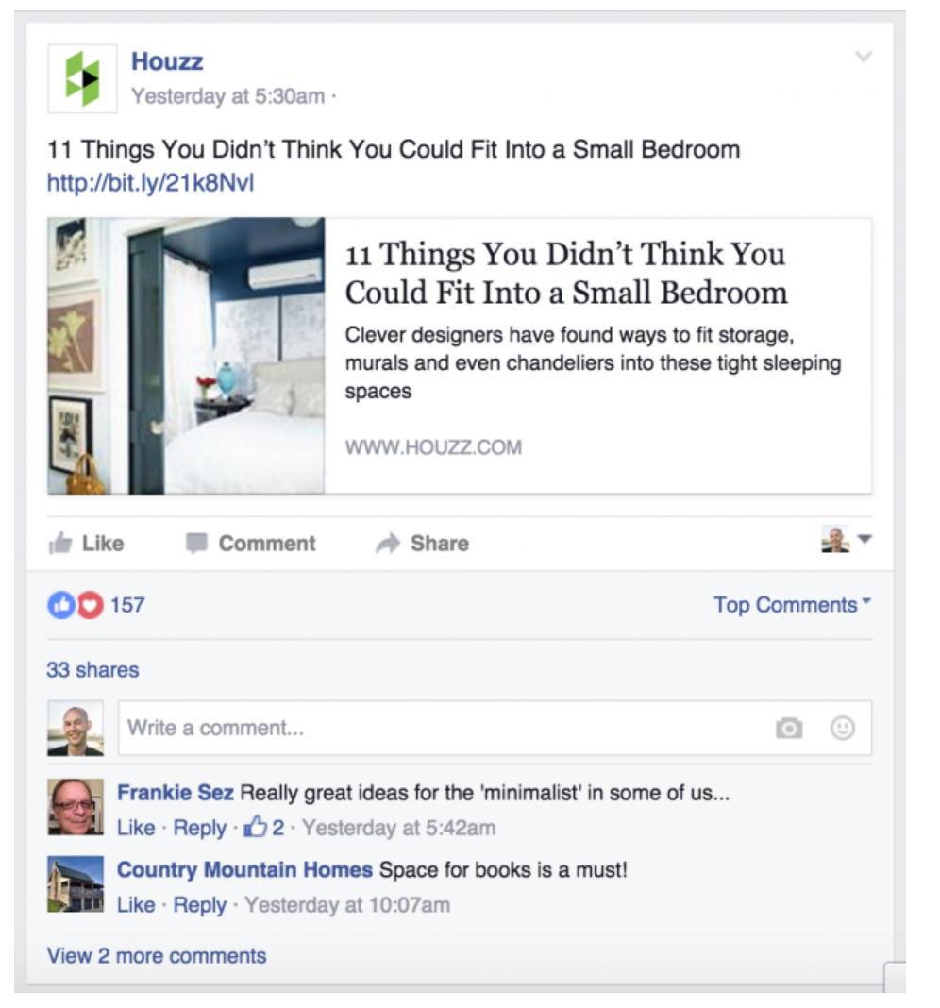
Common region examples
Facebook groups things together within bounding boxes

Slide 15
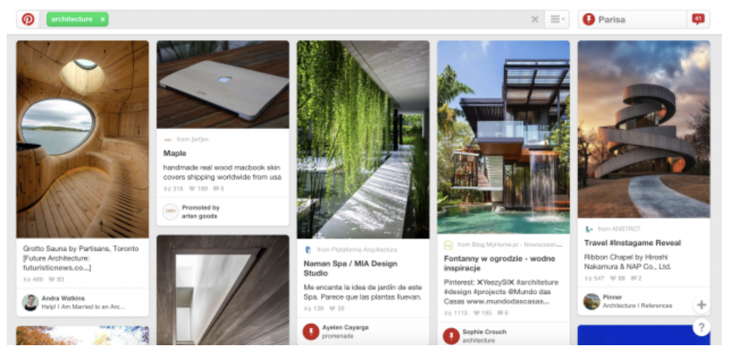
Common region examples
Pinterest groups content about pins in bounding boxes

Slide 16
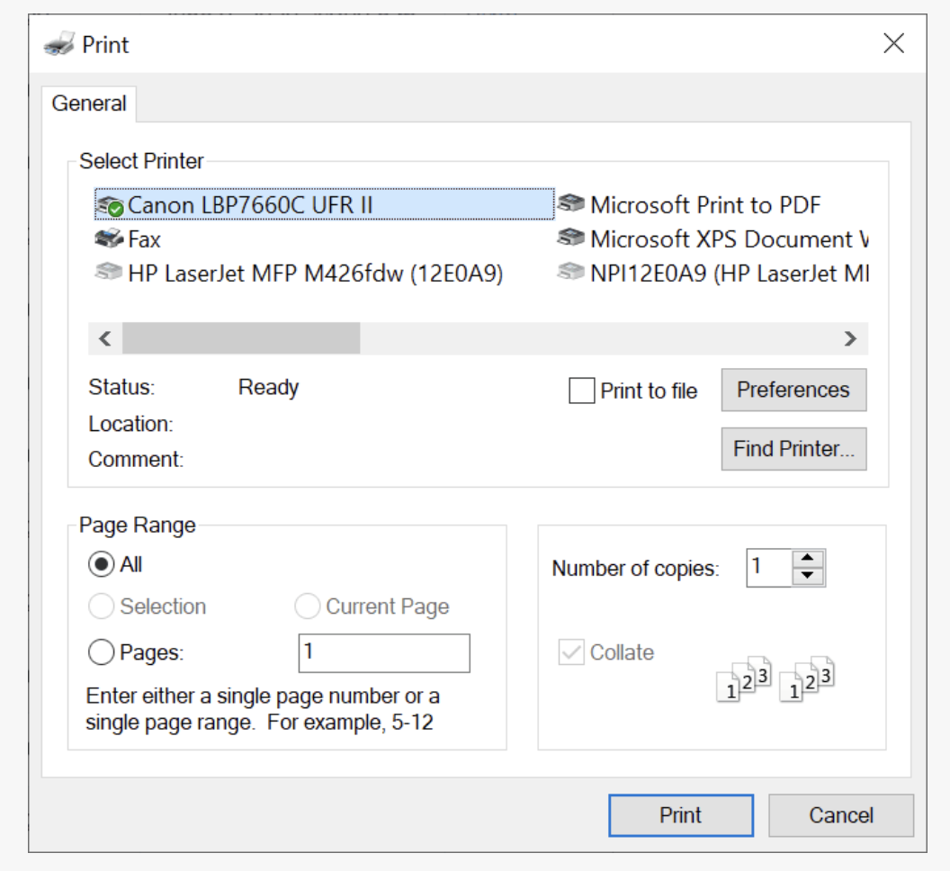
Common region examples
3 regions

Slide 17
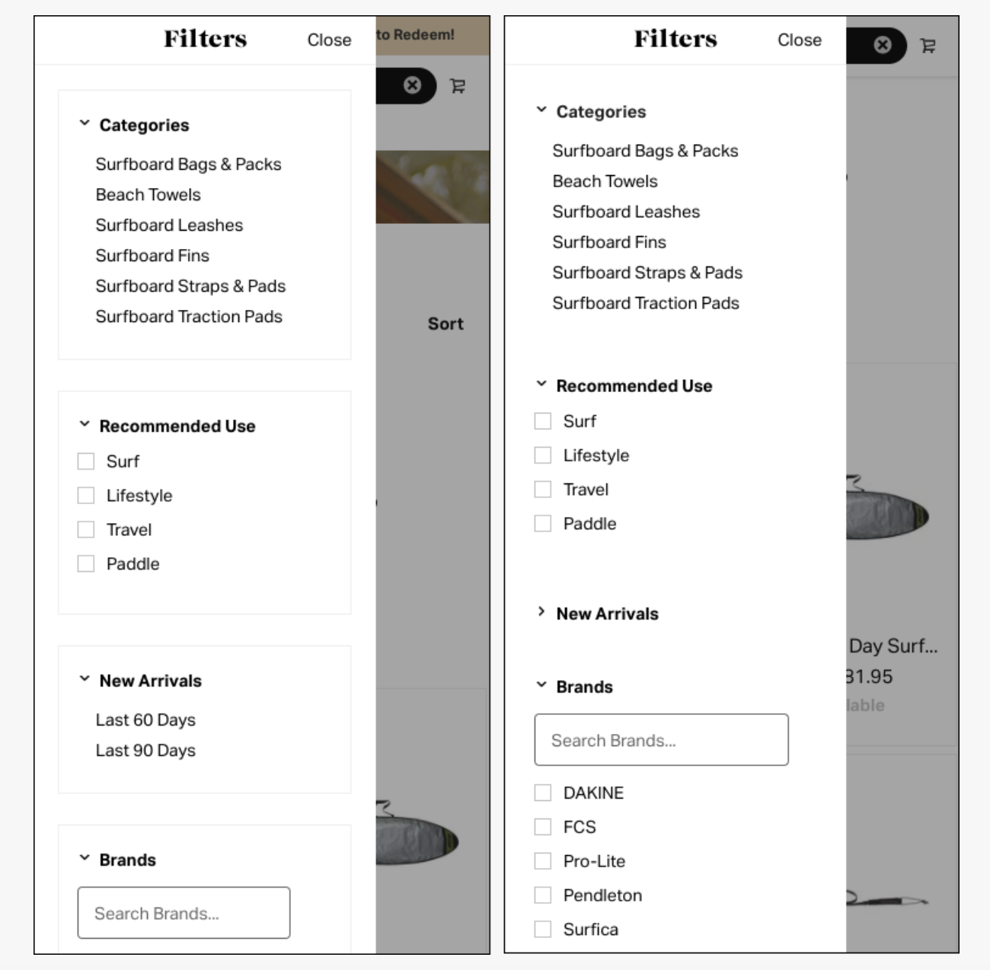
Common groupings caution
Overuse can create clutter

Slide 18
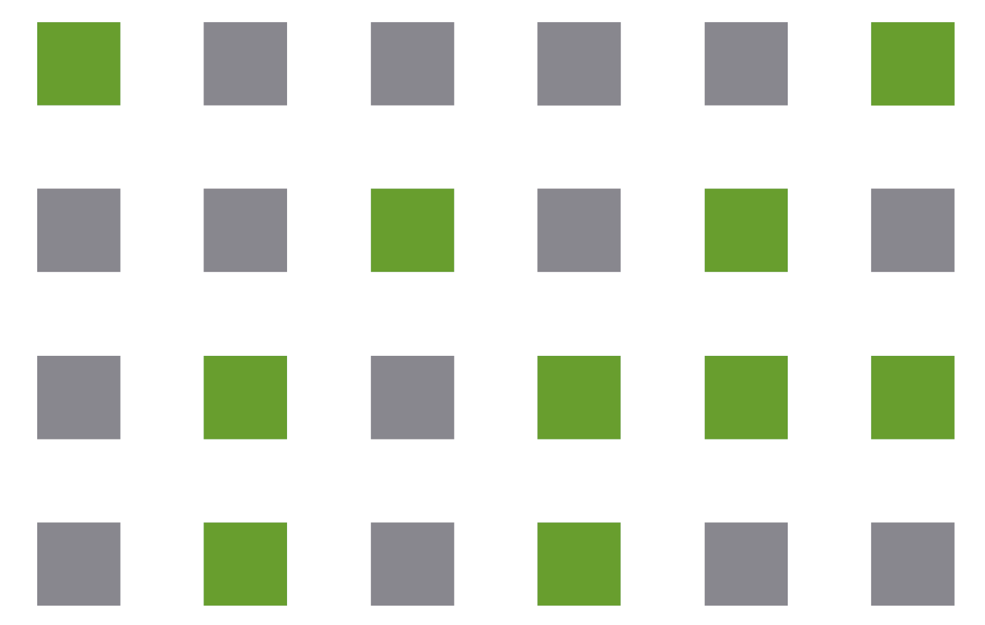
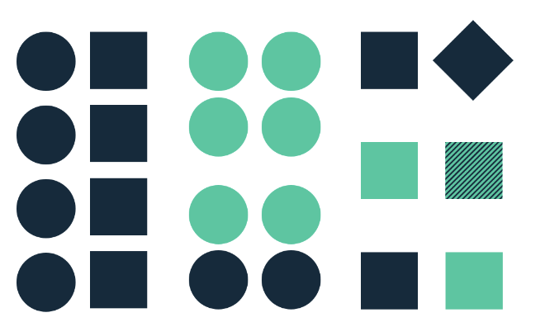
Similarity
Our brains group like things together.
In gestalt, similar elements are visually grouped, regardless of their proximity to each other.
They can be grouped by color, shape, or size.
Similarity can be used to tie together elements that might not be right next to each other in a design.

Slide 19
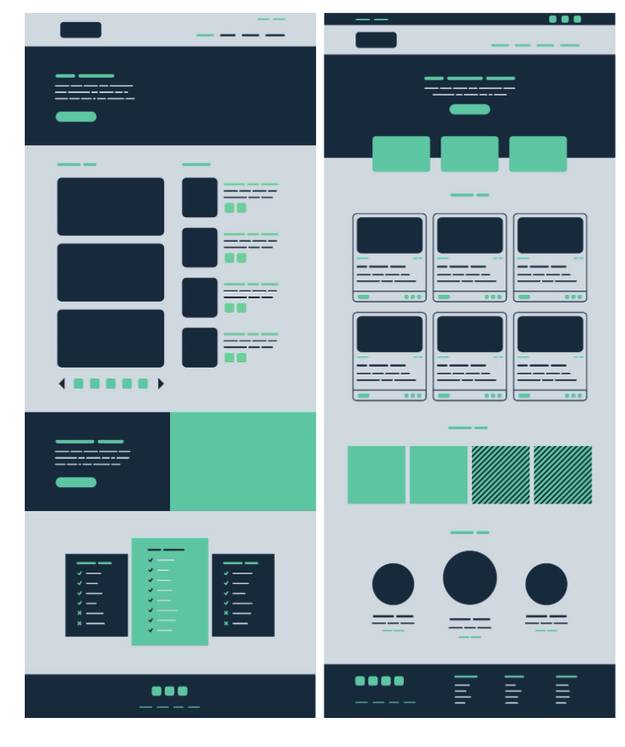
Similarity in UI design
Across the screen, use color, texture, shape, size, to form a connection between things NOT near each other

Slide 20
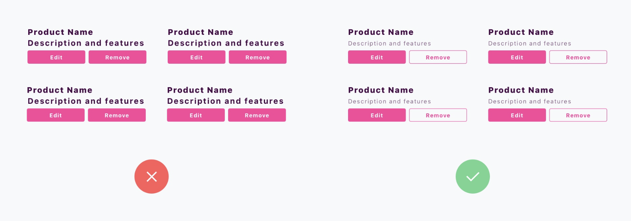
Which uses similarity principle?

Slide 21
Which uses similarity principle?

Slide 22
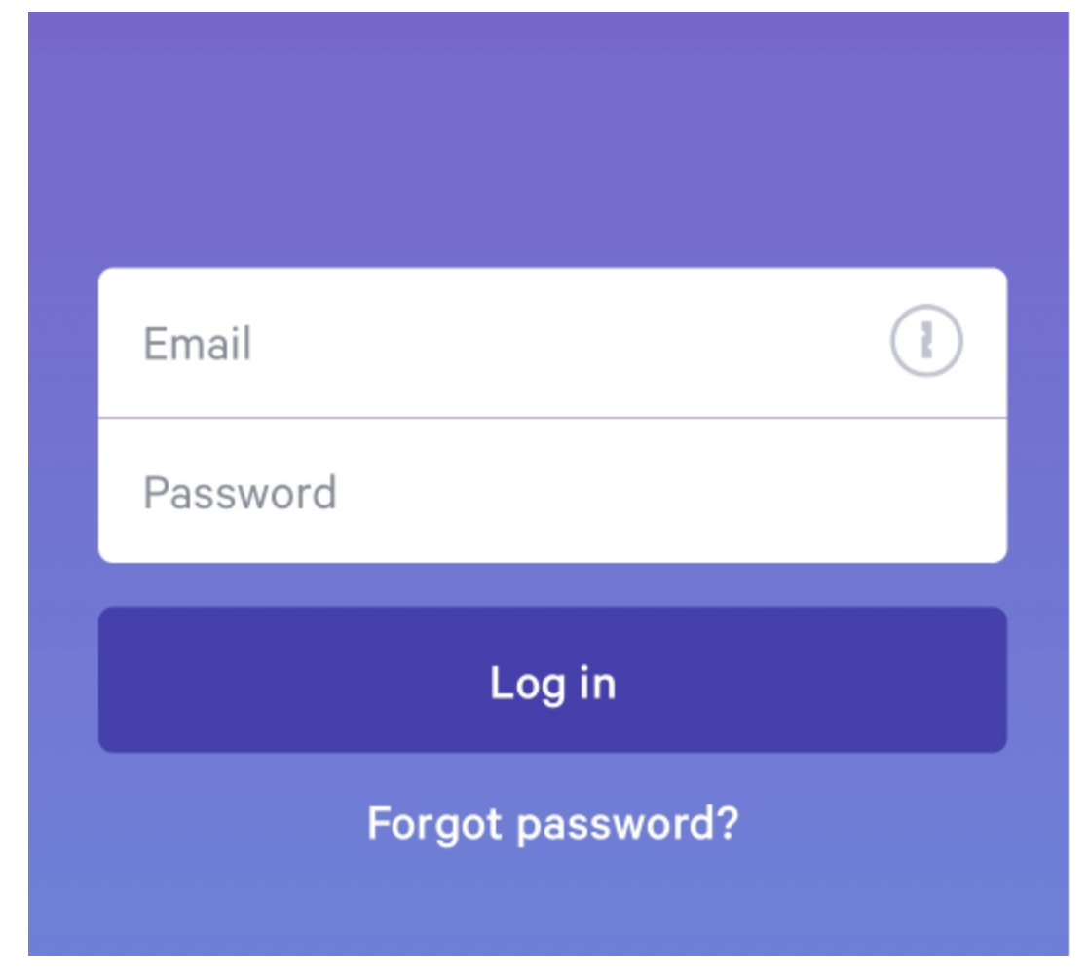
Similarity in UI design example
Two white rectangles signal to our brains- these things are alike

Slide 23
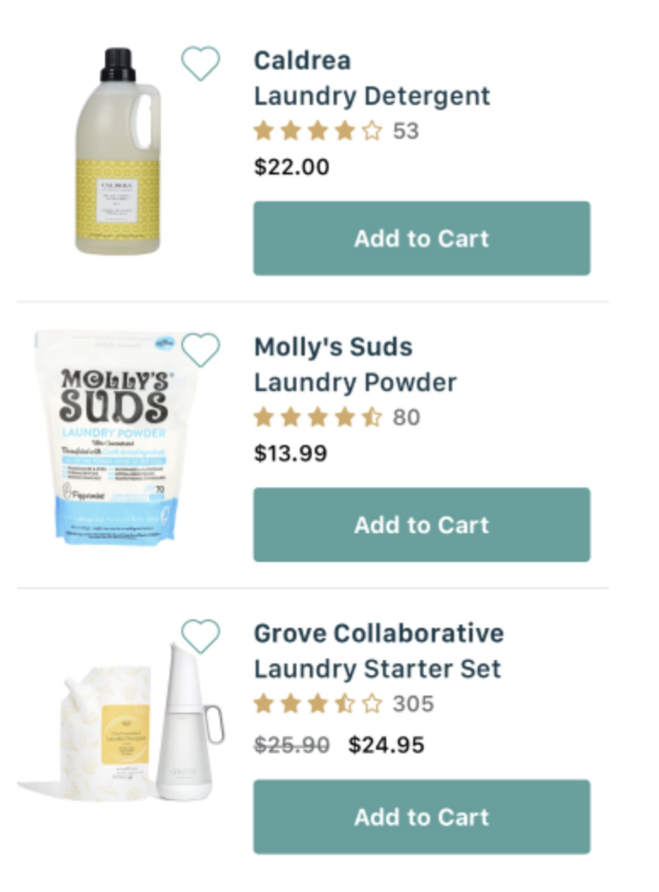
Similarity in UI design example
Similarity helps to establish a hierarchy in building relations between elements that are at a similar level.
Multiple levels of similarity- same sized icon, same sized text, same color for buttons…..

Slide 24
Similarity- make some things stand out
You can make things dissimilar if you want to make them stand out from the crowd.
Buttons for calls to action are often designed in a different color than the rest of a page—so they stand out and draw the visitor’s attention to the desired action.

Slide 25
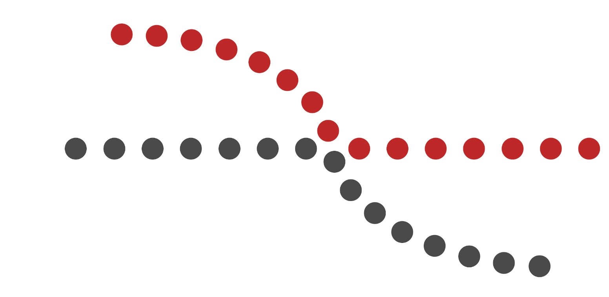
Continuity principle
Our eyes will follow the smoothest path when viewing lines,
Even if not given an actual line
Use this to guide your user’s eyes
They will follow the simplest path on the page, so make sure the most vital parts they should see fall within that path.

Slide 26
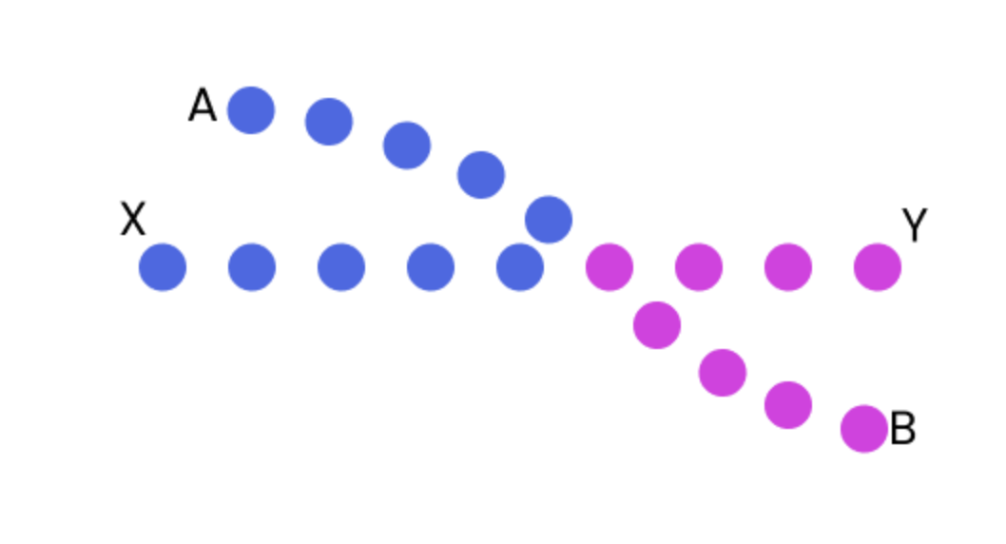
Continuity vs color
What do you associate together?

Slide 27
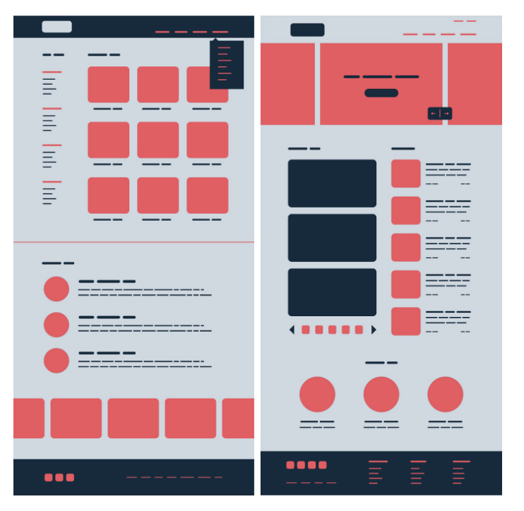
Continuity in UI design
Help guide the eyes
Help the user interpret direction and movement
Do you perceive continuous lines in these separate elements?
Does your eye want to follow them?
Do you perceive them as in a group?

Slide 28
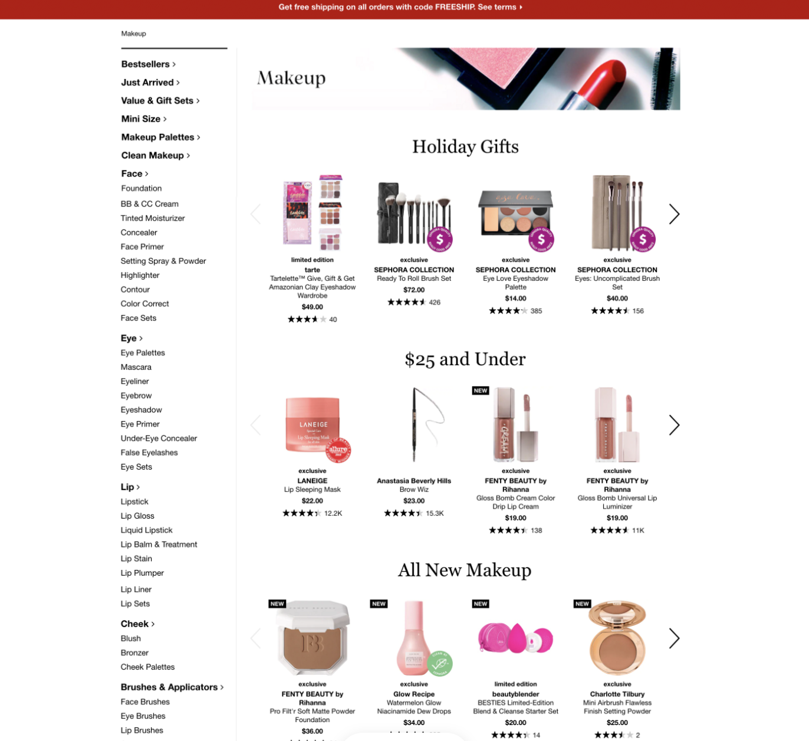
Continuity in UI design
Where do your eyes go for different parts of this UI?
Do you follow along separate elements you perceive as ‘in a line’?

Slide 29
Common fate
Regardless of how far apart are the elements or how dissimilar they might appear, if they are moving or changing together, they are perceived as related.
This effect can take place even when movement is implied, by other visual elements.

Slide 30
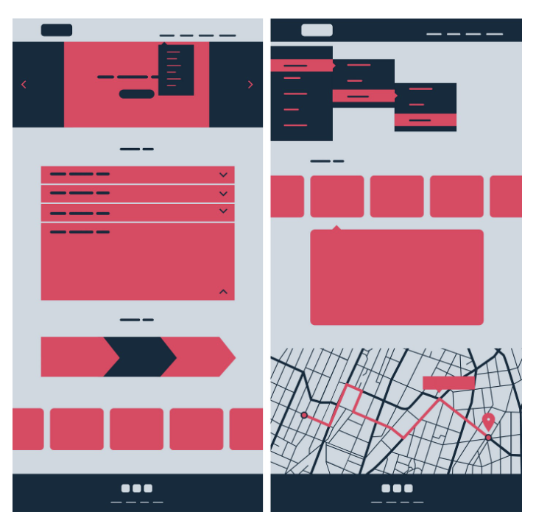
Common fate and UI design
Common fate in carousels, drop down menus, accordion sliders….
Things that move, open, close, shift, together

Slide 31
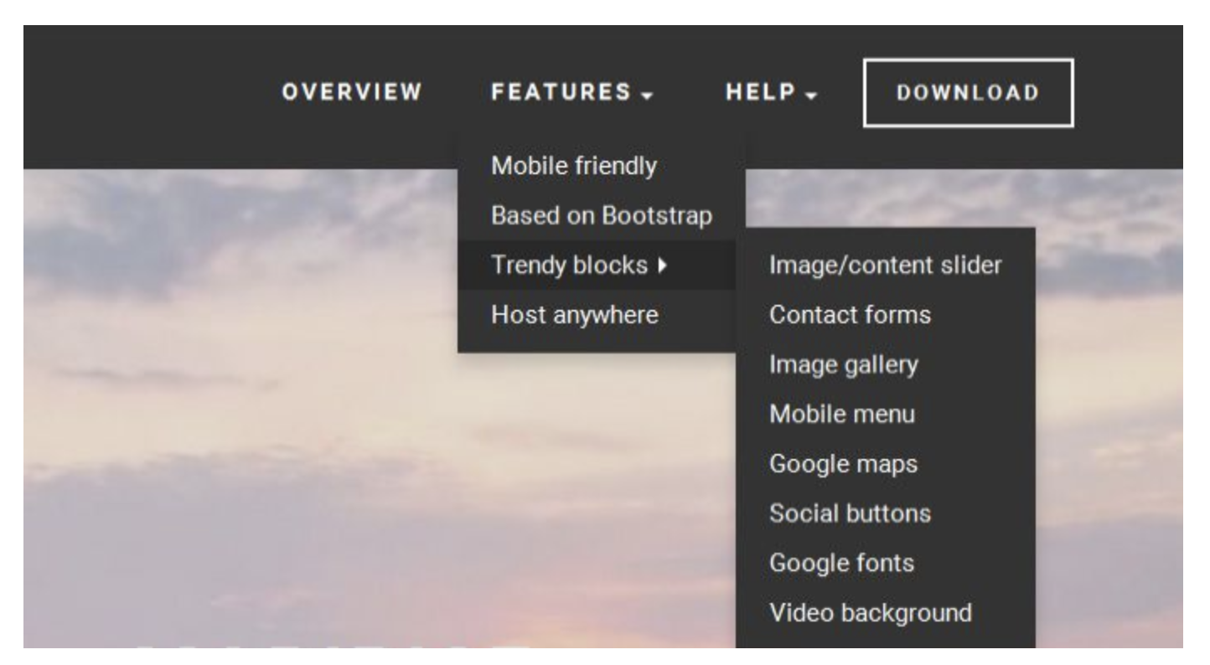
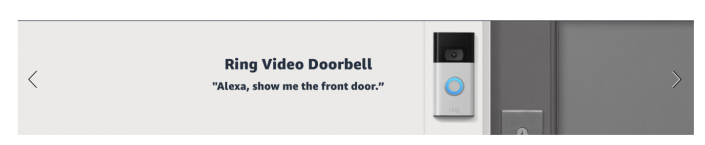
Common fate principle
Carousel, drop downs
When the items move together, we think of them as belonging together

Slide 32

Closure principle
Our brains complete the image
Example: Show a partial image fading off the user’s screen in order to show them that there is more to be found if they swipe left or right.
Without a partial image, i.e., if only full images are shown, the brain doesn’t immediately interpret that there might be more to be seen, and therefore your user is less likely to scroll (since closure is already apparent).

Slide 33

Closure in UI design
Important in iconography

Slide 34
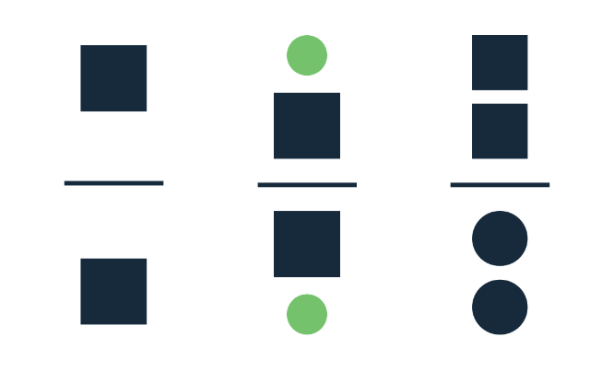
Symmetry
Our mind perceives symmetrical objects as parts of the same group. They create an impression of stability and order.
UI Elements that are symmetrical to each other helps to scan the content and recognize patterns. Symmetry allows users to focus on what is essential. Symmetrical navigation menus tend to be perceived as more stable. The principle is excellent to use when you design galleries or banners.
On the other hand, some asymmetry in design can make it more exciting and dynamic.

Slide 35
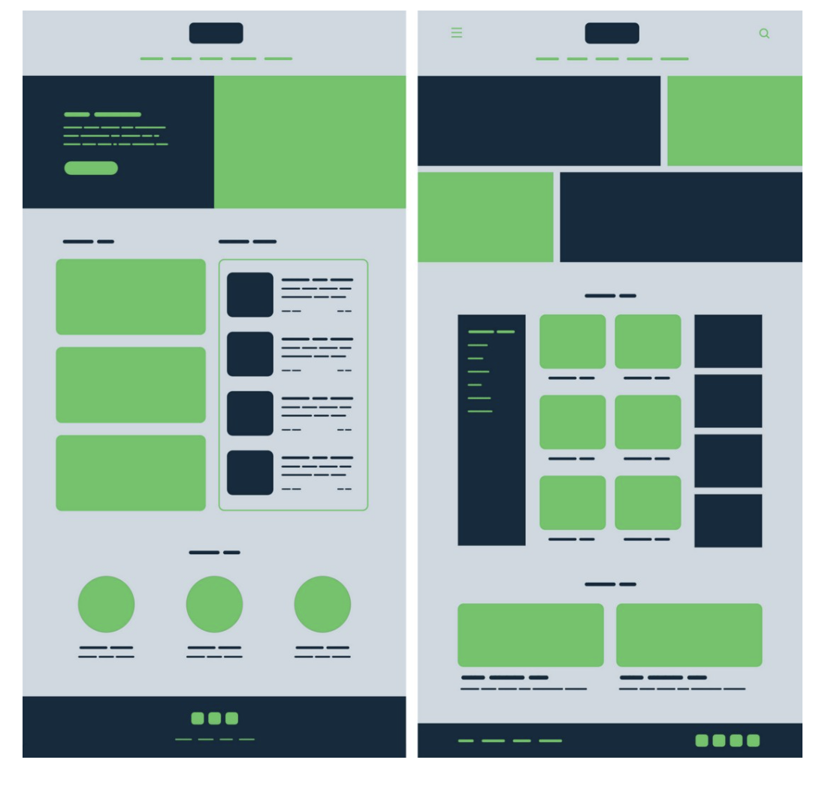
Symmetry and UI design
UI Elements that are symmetrical to each other helps to scan the content and recognize patterns.
Symmetry allows users to focus on what is essential.
Symmetrical navigation menus tend to be perceived as more stable.
Use when you design galleries or banners.
Some asymmetry in design can make it more exciting and dynamic.

Slide 36
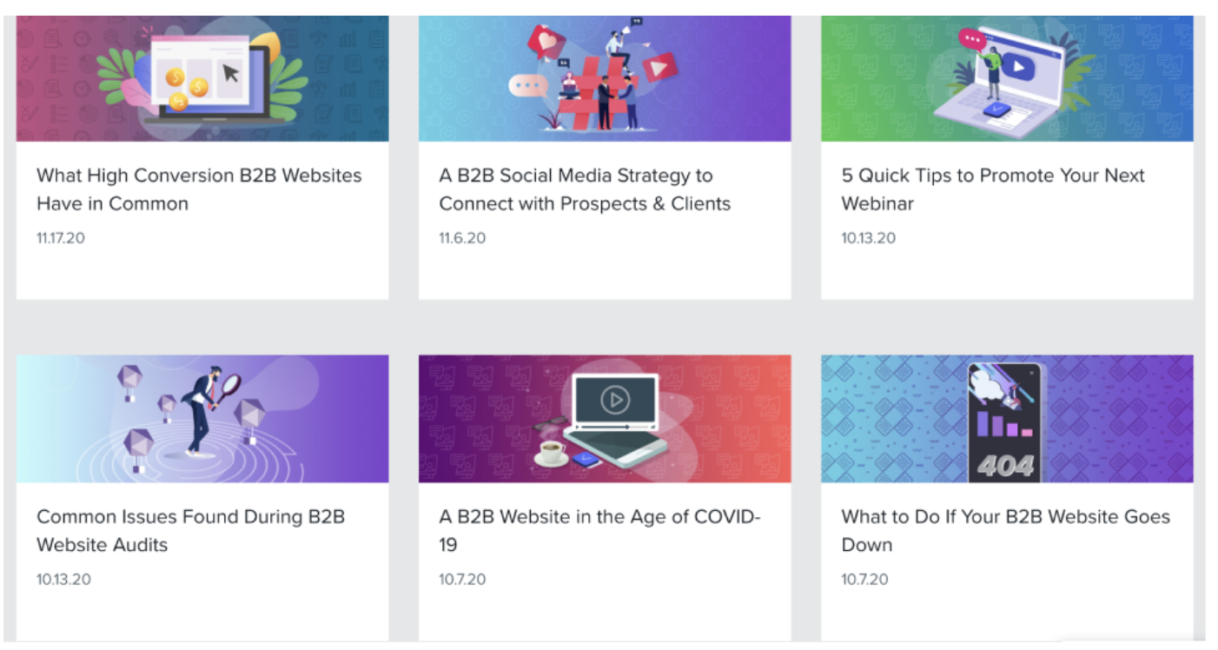
Symmetry and UI design example

Slide 37

Figure/Ground principle
People instinctively perceive objects as either being in the foreground or the background. They either stand out prominently in the front (the figure) or recede into the back (the ground).

Slide 38
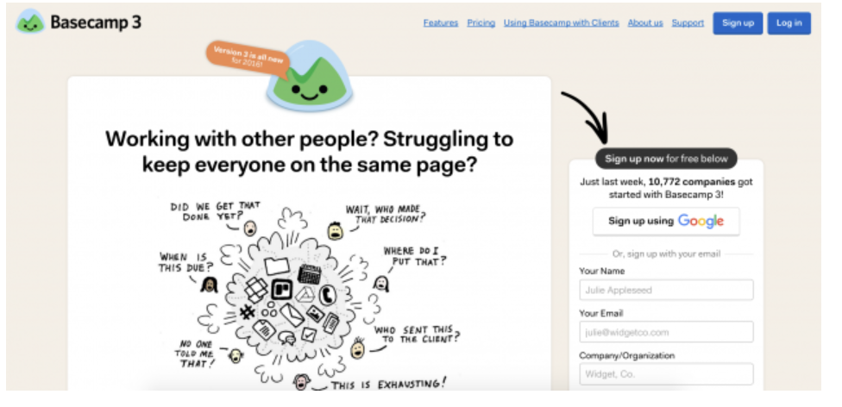
Figure/ground principle examples
We know to focus on the white regions on this page

Slide 39
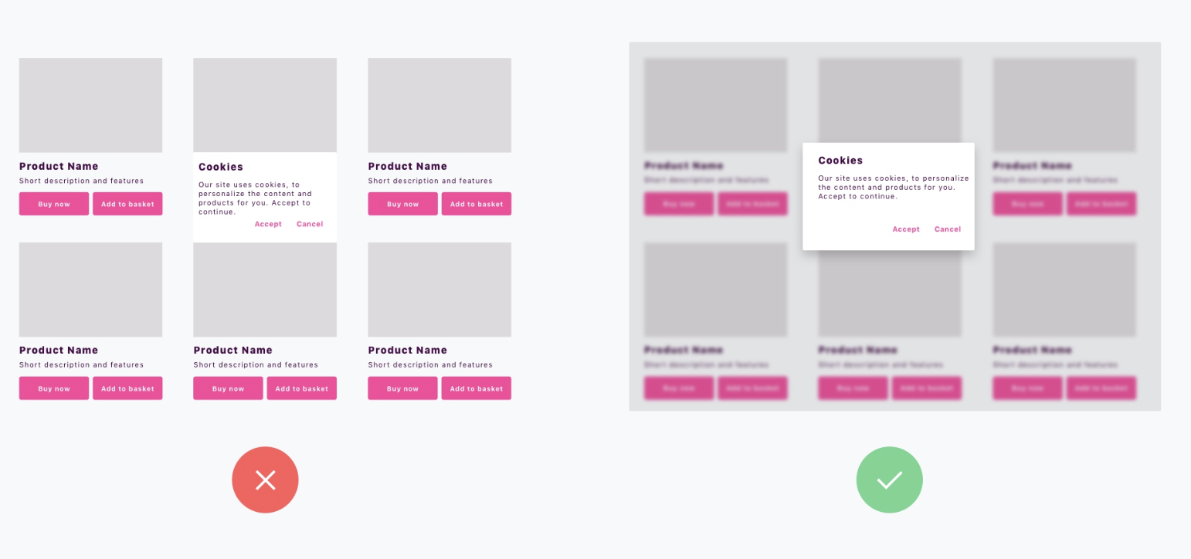
Figure ground principle examples

Slide 40
How to use these principles
These can give you labels for when things are working (‘Oh, my eyes follow here, because of the continuity principle) or not working (‘Maybe I need to group elements in a bounding box, to help the user associate them together?’)

Slide 41
Slide credits
Debaleena Chattopdhay
https://www.toptal.com/designers/ui/gestalt-principles-of-design#:~:text=There%20are%20six%20individual%20principles,gestalt%2C%20such%20as%20common%20fate.
https://balsamiq.com/learn/articles/visual-hierarchy-and-alignment/
https://www.interaction-design.org/literature/article/simplicity-in-design-4-ways-to-achieve-simplicity-in-your-designs
https://tomkenny.design/articles/false-simplicity
https://medium.muz.li/gestalt-principles-in-ui-design-6b75a41e9965
https://uxmisfit.com/2019/04/23/ui-design-in-practice-gestalt-principles/
https://www.usertesting.com/resources/topics/gestalt-principles#:~:text=Principle%20%234%3A%20common%20region&text=It%20states%20that%20when%20objects,them%20as%20being%20grouped%20together.&text=Adding%20borders%20or%20other%20visible,%2C%20size%2C%20color%2C%20etc.
https://www.nngroup.com/articles/common-region/
https://katecodonnell.medium.com/gestalt-and-design-symmetry-29fdde5b24e0
https://www.toptal.com/designers/ui/gestalt-principles-of-design

Slide 42
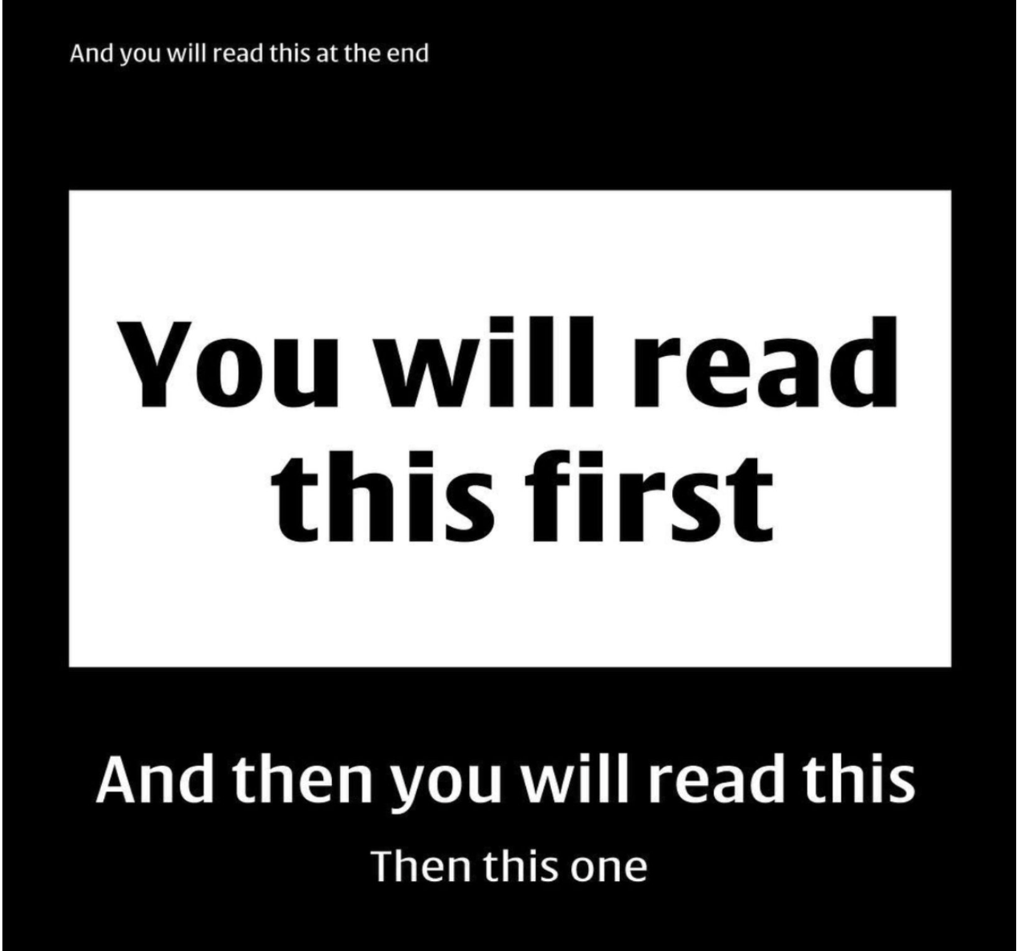
How we ‘read’
Anyone surprised?

Slide 43
Visual hierarchy
We visually scan the world
We need to direct our attention to perceive elements
This impacts our behavior when interacting with digital interfaces.

Slide 44
Visual hierarchy
Important to understand the levels of attention each item on your UI will get
People will understand whatever it is that you’re wanting them to more quickly, with less effort.
Visual hierarchy and alignment helps you direct your user’s attention, helps them ‘read’ the content on the page

Slide 45
Visual hierarchy
Lack of visual hierarchy and poorly aligned content interrupts your brain's ability to scan and zone-in on areas of interest. If we cannot quickly understand what we see, we become frustrated and will likely leave the experience.

Slide 46
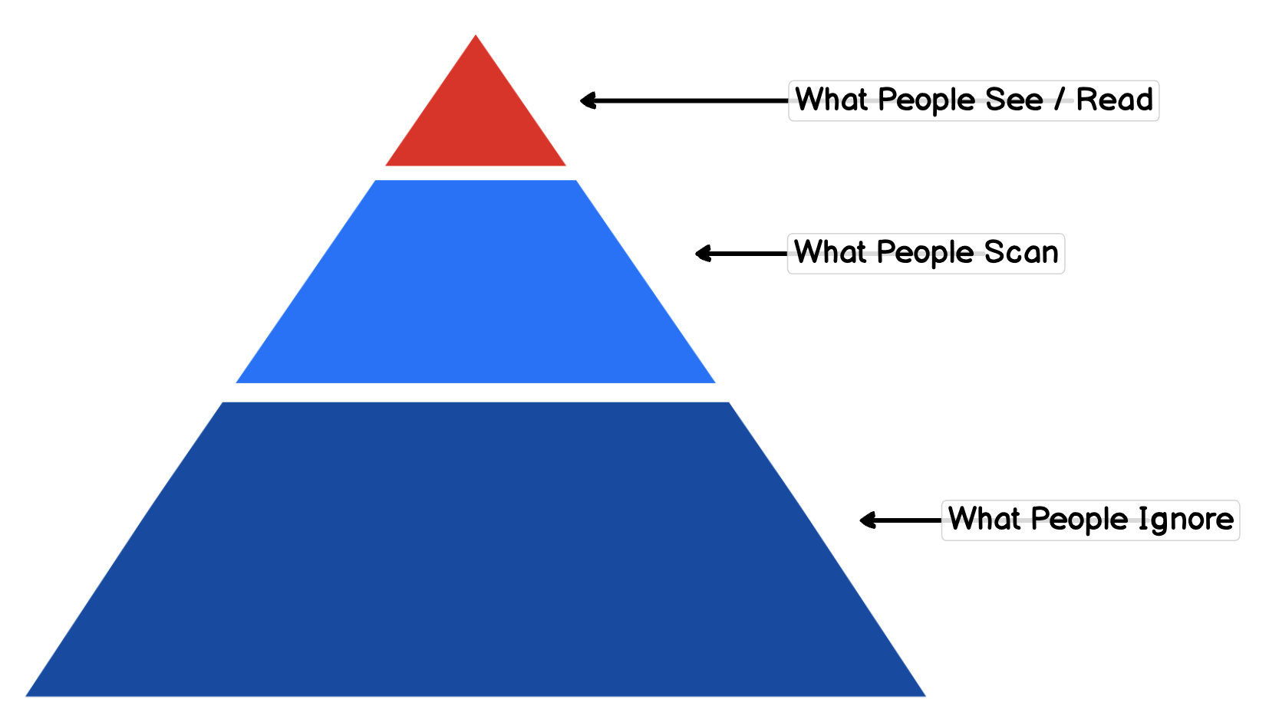
Visual Hierarchy
Remember – our brains don’t take in everything!

Slide 47
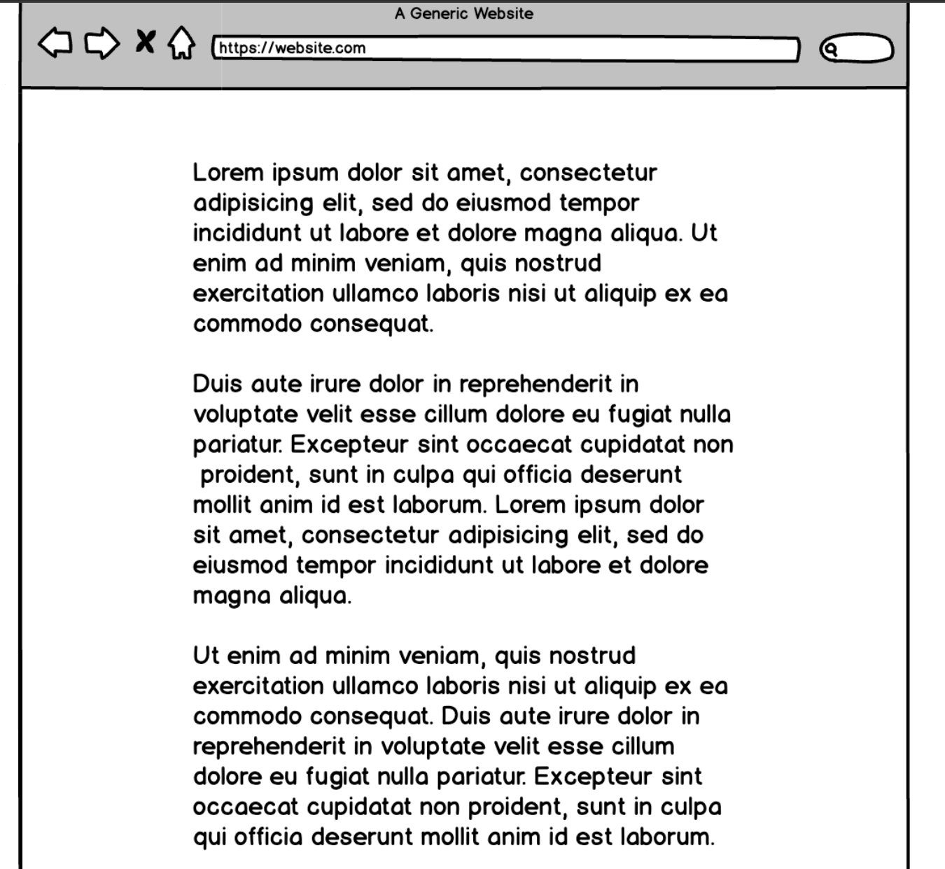
Example page with no hierarchy

Slide 48
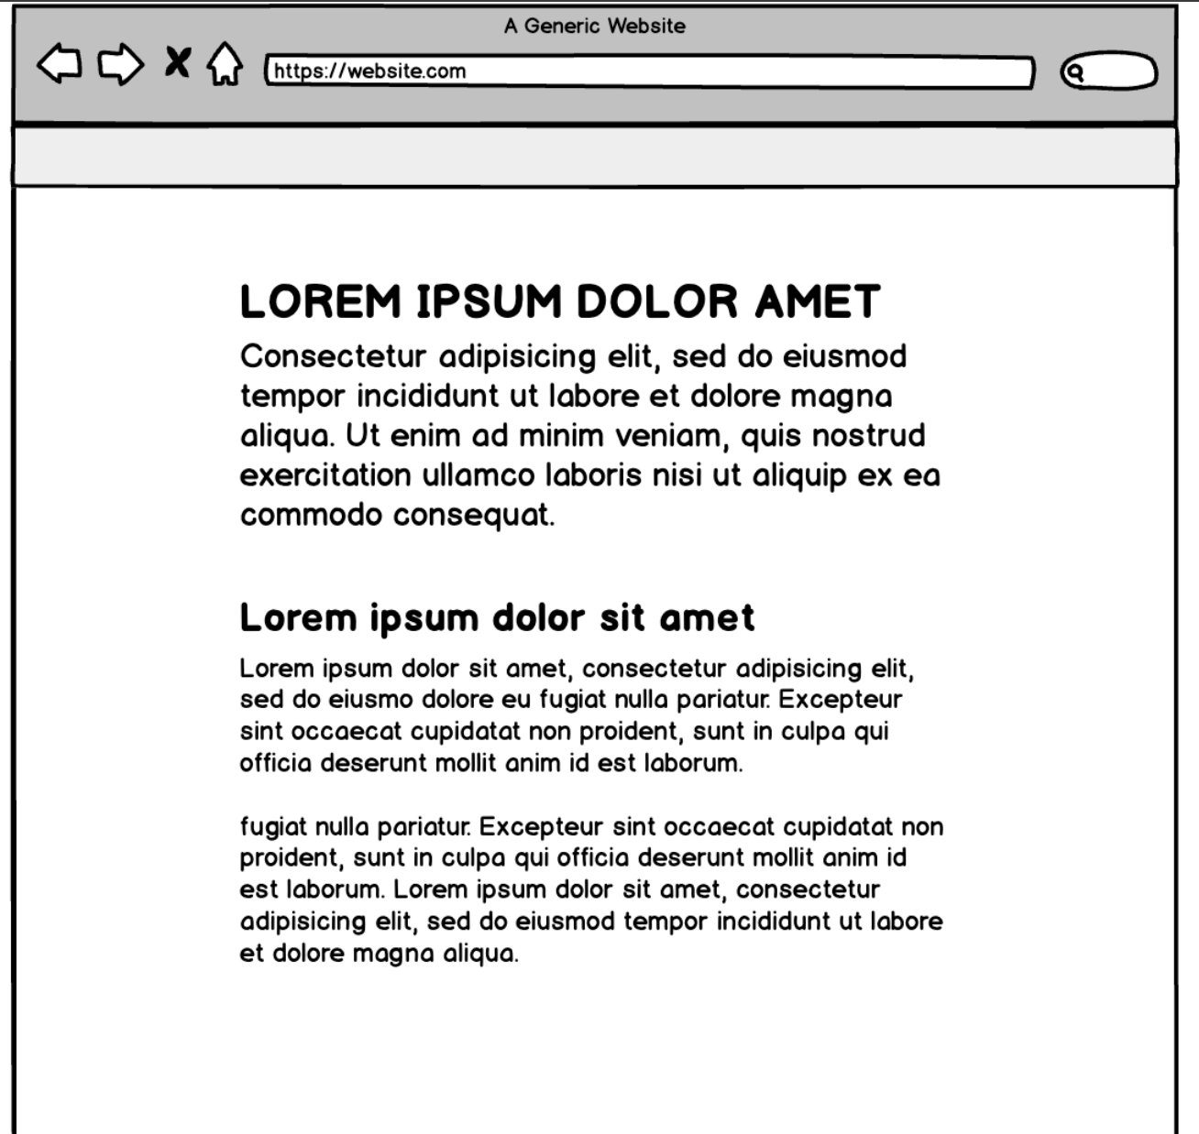
Better?

Slide 49
With no hierarchy….
With no hierarchy or places for your eyes to go:
We cannot focus
Must use more of our attention to discern where we need to go next.
Sometimes this is used intentionally.
When you place equal weight on the items on your page you are confusing your users.
It’s a common dark pattern sites use when they don't want you to take action at all (e.g., to cancel your membership).

Slide 50
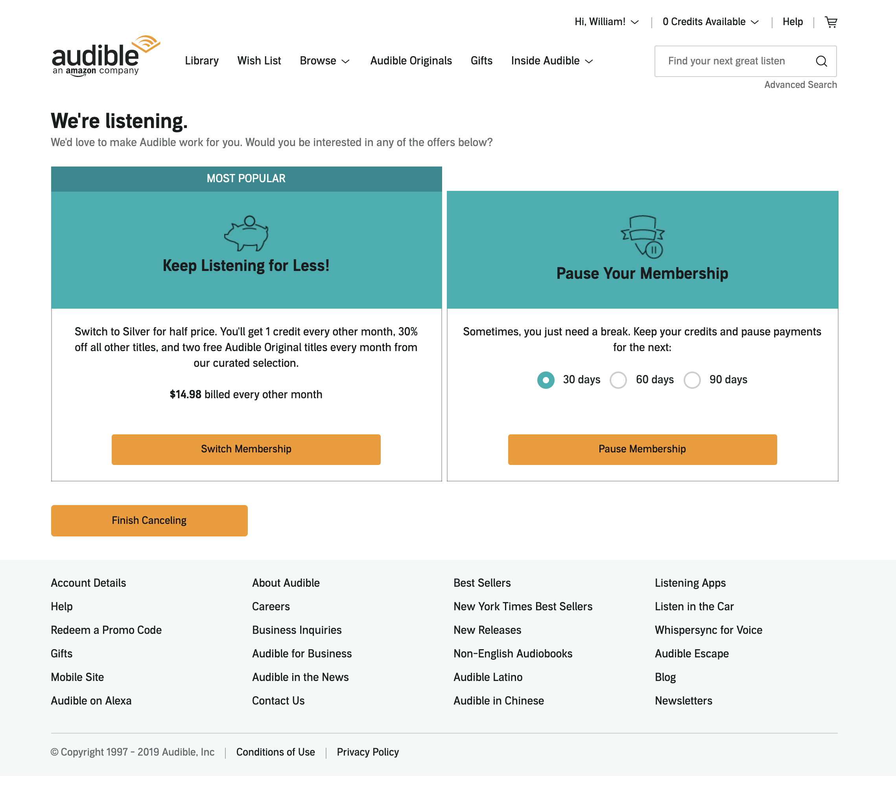
With no hierarchy…. Dark pattern

Slide 51
Alignment
Alignment helps people scan and helps draw their attention
Makes an interface more interpretable

Slide 52
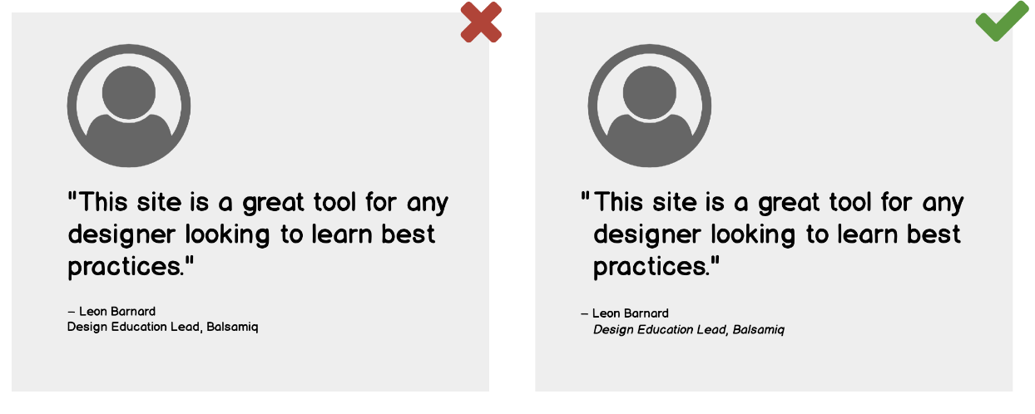
Which do we like better? Can we spot the difference?

Slide 53
Can we spot the difference?
Text is aligned with text
Not with the quotation mark
Claim: Makes it easier to scan

Slide 54
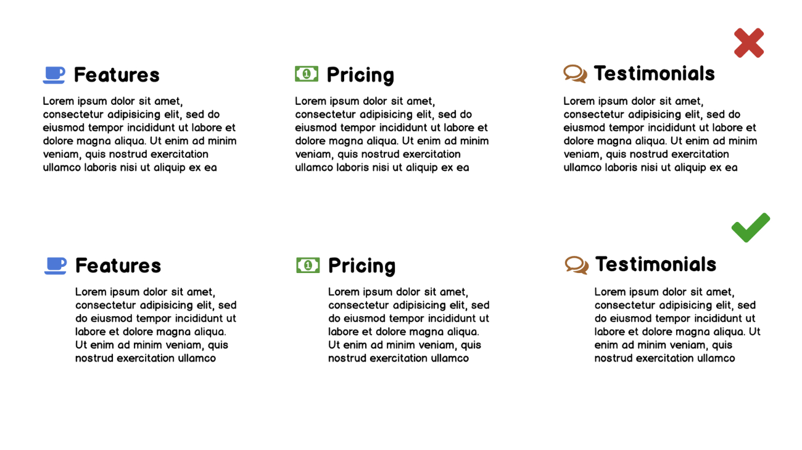
Another example
The bottom version will allow users to scan the text more smoothly

Slide 55
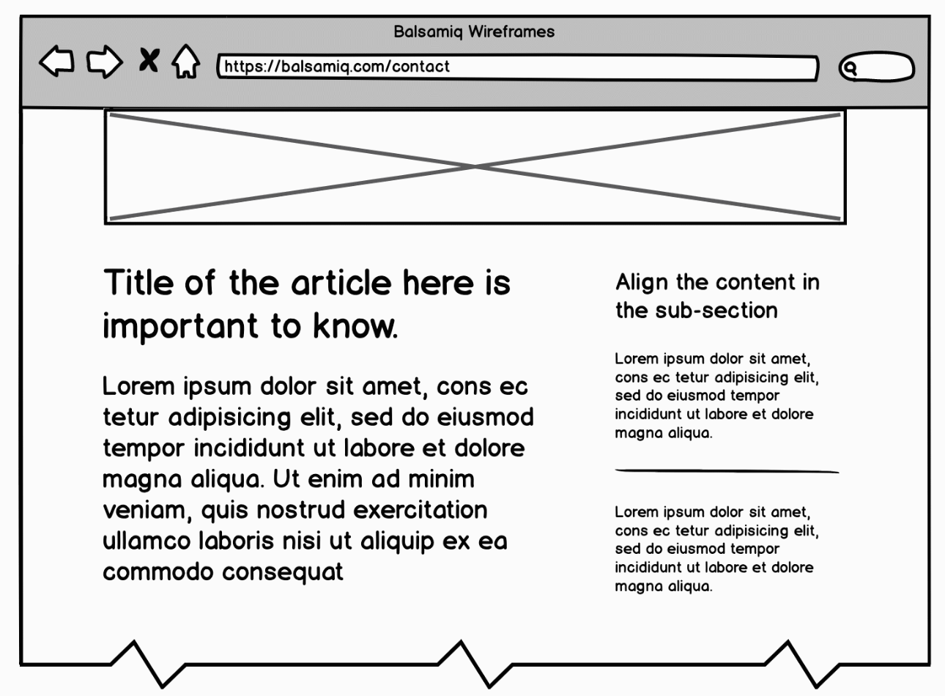
Horizontal Alignment
Let’s look at this example

Slide 56
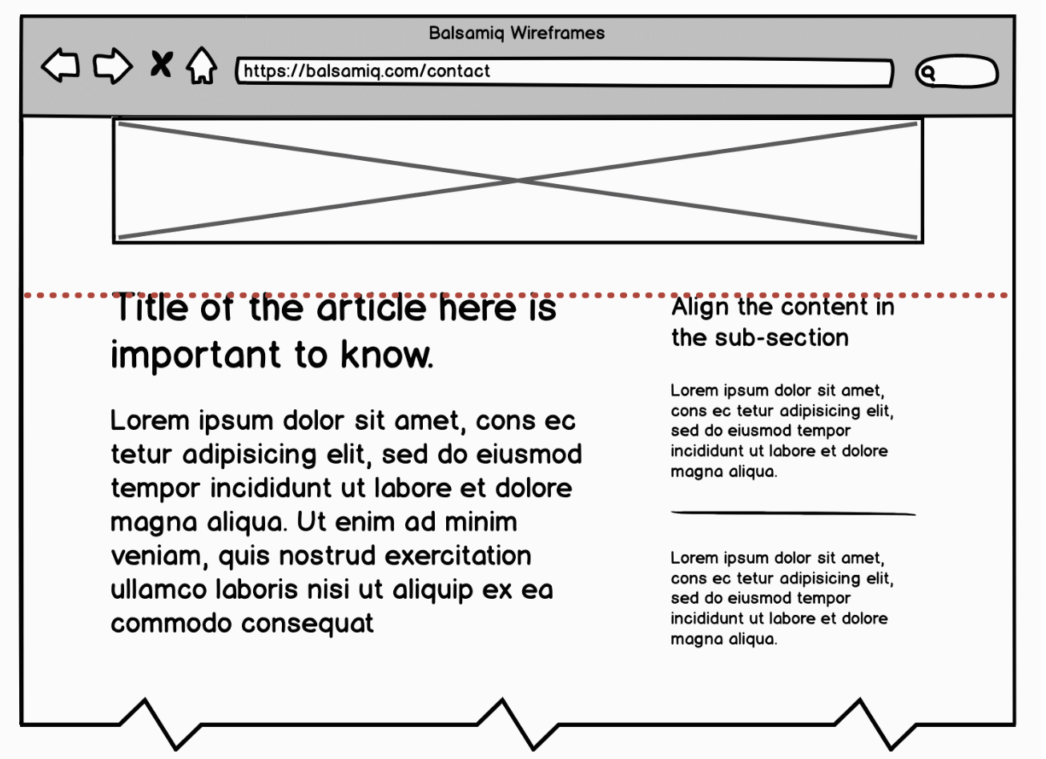
Horizontal Alignment
Let’s look at this example
The horizontal alignment of the text makes it easier to scan

Slide 57
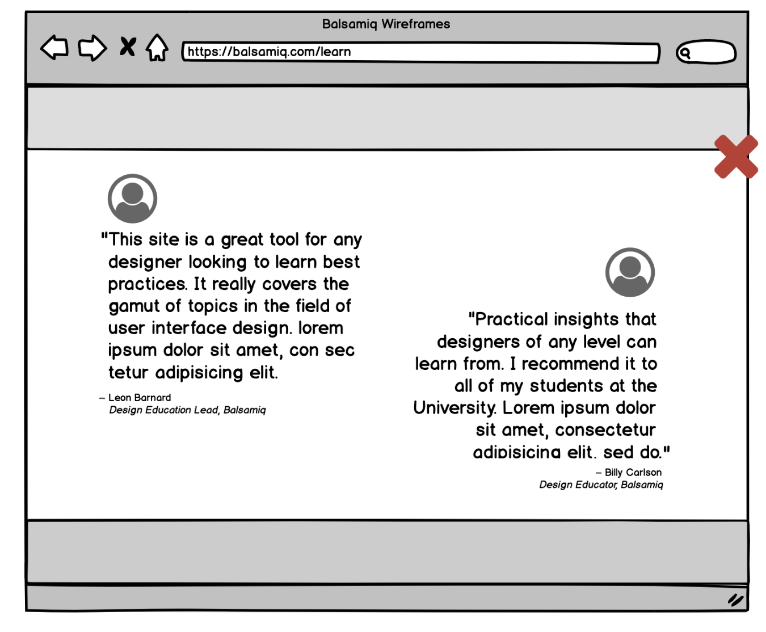
Horizontal Alignment and Eyeline
Look at this example
2 pieces of content
In the same ‘eyeline’
Our brains want to jump horizontally to the next piece of content.
This makes it hard to focus on the first bit of content.
Overlapping can cause disruptions to comprehending the content.

Slide 58
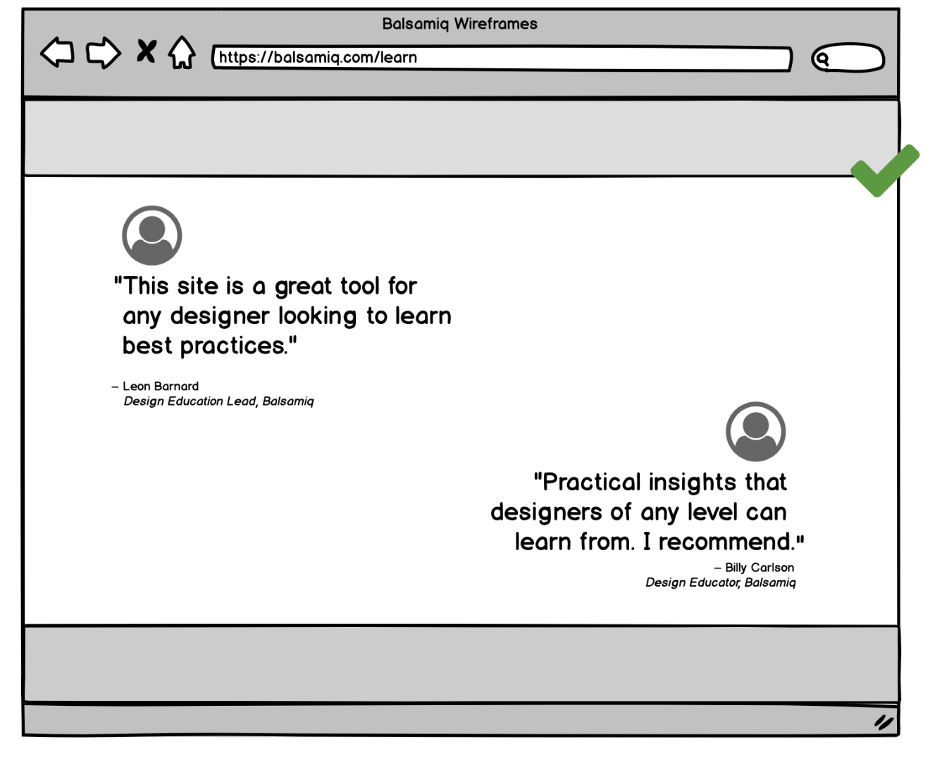
Horizontal alignment: Eyeline
Give some vertical space between things so the user can easily look at each area separately.

Slide 59
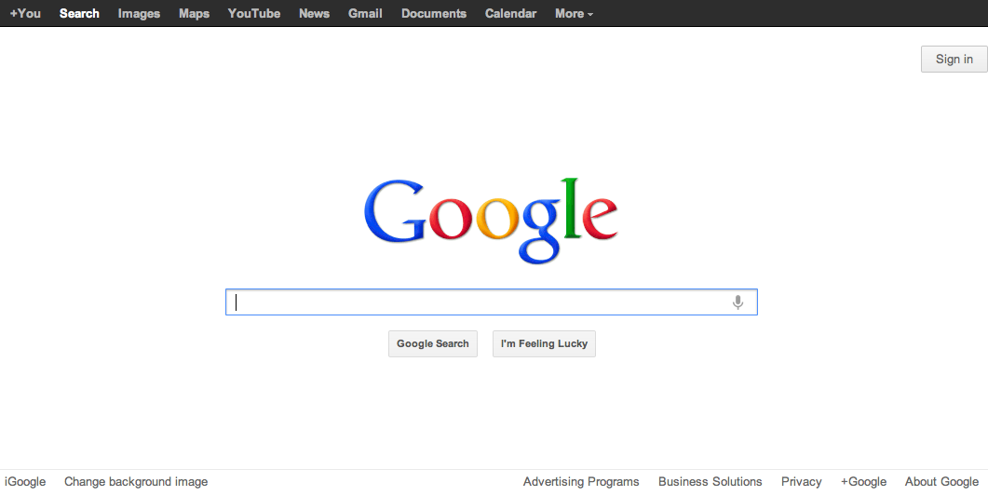
How to use balance and symmetry in UI design
We talked about the value of symmetry in creating a sense of order
How to achieve symmetry
Choose an axis (usually vertical)
Distribute elements equally around the axis
Equalize both mass and extent

Slide 60
But not everything needs to be symmetrical all the time

Slide 61
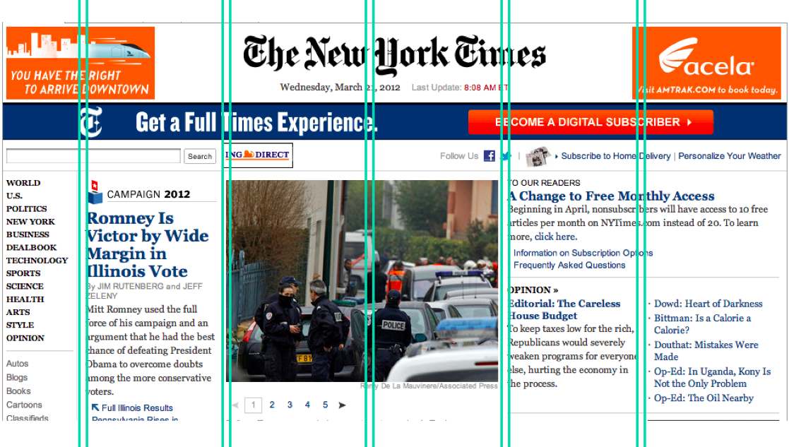
Grid-based design
A grid is one effective way to achieve both alignment and balance, nearly automatically.
A grid means that you divide the user interface into equal-width columns
separated by gaps, and with margins on both sides of the window
align content and controls on the column boundaries.
Some elements may span multiple columns, but they align (start or end at) column boundaries

Slide 62
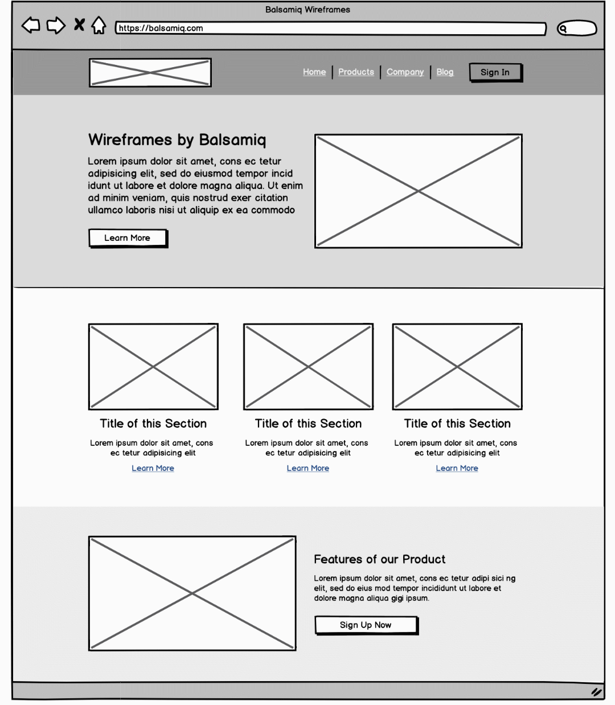
Grid-based design
Let’s find the alignment

Slide 63
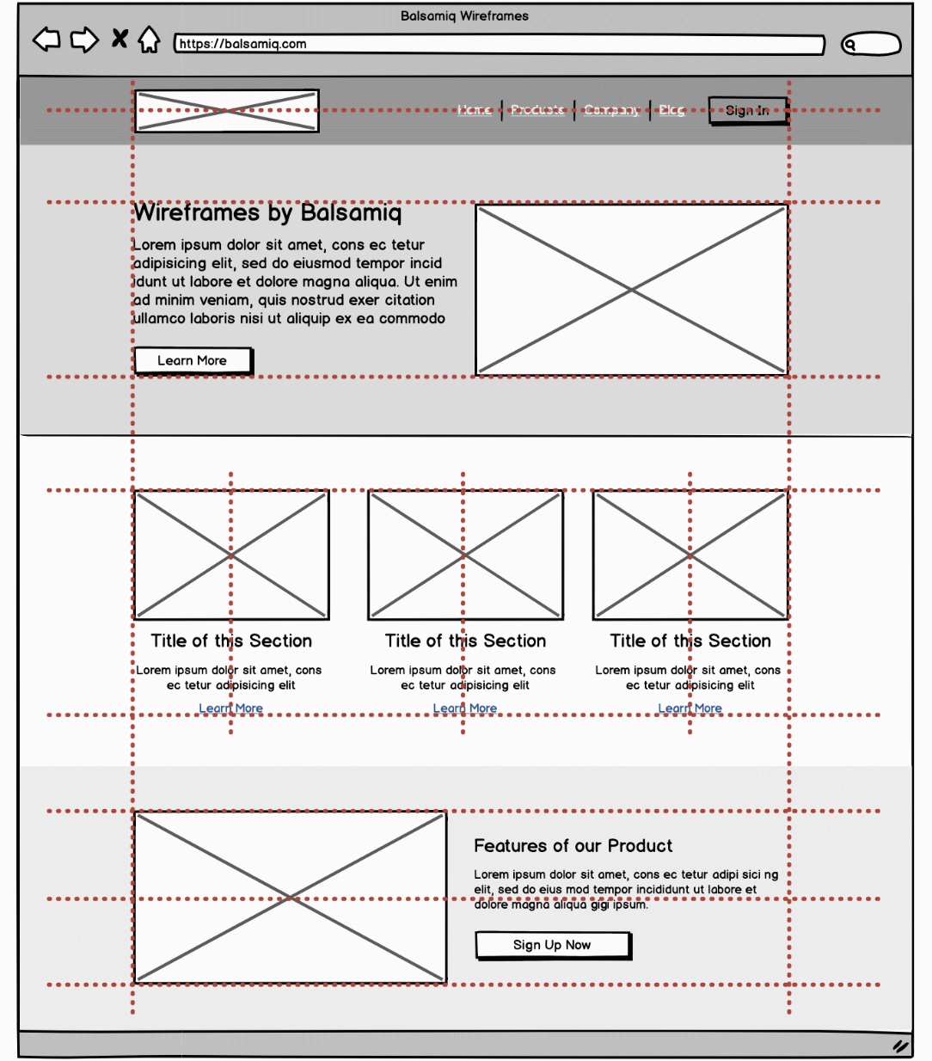
Grid-based design
So many places of alignment

